Slide 1
Introduction to Programming CS1133

Slide 2
Scope
The scope of a variable: the part of the program in which the variable can be accessed
A variable cannot be used before it is defined
Example:…

Slide 3
Scope
Different levels of scope:
Function scope
block scope
File scope
Class scope
Local variables
Global variables

Slide 4
Scope
Function scope example…
Block scope example…
File scope example…

Slide 5
Visibility
→ A variable is visible within its scope, and
invisible or hidden outside it.

Slide 6
Lifetime of Variables
The lifetime of a variable is the interval of time in which storage is bound to the variable.
The action that acquires storage for a variable is called allocation.

Slide 7
Lifetime of Variables
Local Variables (function and block scope) have lifetime of the function or block
Global variable (having file level scope) has lifetime until the end of program
Examples…

Slide 8
Literals Constants
Built-in types
Boolean type
bool
Character types
char
Integer types
int
and short and
long
Floating-point types
double
and float
Standard-library types
string
Literals
Boolean: true, false
Character literals
– 'a', 'x', '4', '\n', '$'
Integer literals
– 0, 1, 123, -6,
Floating point literals
– 1.2, 13.345, 0.3, -0.54,
String literals
– "asdf”, “Helllo”, Pakistan”

Slide 9
Constants (named)
Named constants are declared and referenced by identifiers:
const int max_marks = 100; // (MAX_MARKS rec..)
const string UNIVERSITY = “ALI"; const double PI = 3.141592654; const char TAB = '\t';
Constants must be initialized in their declaration
No further assignment possible within program

Slide 10
Binary Arithmetic Operators
Name | Meanin
+ | Addition | 34 | + | 1 | 35
- | Subtraction | 34.0 |  | – | 0.1 | 33.9
* | Multiplication | 300 | * | 30 |  | 9000
/ | Division | 1.0 | / | 2.0 |  | 0.5
% | Remainder | 20 | % | 3 |  | 2
Remainder operator is also known as modulus operator

Slide 11
Integer and Real Division
float result = 5 / 2; // ➔ result equal to 2
float result = 5.0 / 2;
// ➔ result equal to 2.5
If any of the operand is a real value (float or double) the division will be performed as “Real Division”

Slide 12
Remainder/Modulus operator
Operands of modulus operator must be integers
34 % 5 (valid, result → 4)
-34 % 5 (valid, result → -4)
34 % -5 (valid, result → 4)
-34 % -5 (valid, result → -4)
34 % 1.2 is an Error

Slide 13
Arithmetic Expressions
Convert following expression into C++ code
3 + 4x ₋ 10( y − 5)(a + b + c) ₊ ₉₍ 4 ₊ 9 + x ₎
5 x x y
result =
is translated to
result = (3+4*x)/5 – (10*(y-5)*(a+b+c))/x + 9*(4/x + (9+x)/y)

Slide 14
Example: Converting Temperatures
- Write a program that converts a Fahrenheit to Celsius using the formula:
celsius = ( ⁵ )( fahrenheit− 32)
9

Slide 15
Shorthand/Compound Assignment Operators
Operator | Example | Equivalent
+= | i += 8 | i = i + 8
-= | f -= 8.0 | f = f - 8.0
*= | i *= 8 | i = i * 8
/= | i /= 8 | i = i / 8
%= | i %= 8 | i = i % 8

Slide 16
Increment and Decrement Operators
Operator | Name | Description
++var | preincrement | The expression (++var) increments var by 1 and
 |  | evaluates to the new value in var after the increment.
var++ | postincrement | The expression (var++) evaluates to the original value
 |  | in var and increments var by 1.
--var | predecrement | The expression (--var) decrements var by 1 and evaluates to the new value in var after the decrement.
var-- | postdecrement | The expression (var--) evaluates to the original value
 |  | in var and decrements var by 1.

Slide 17
Increment and Decrement Operators
Evaluate the followings:
int val = 10;
int result = 10 * val++; cout<<val<<“ “<<result;
int val = 10;
int result = 10 * ++val; cout<<val<<“ “<<result;

Slide 18
Using ++, -- on “char” type
- The increment and decrement operators can also be applied on char type variables:
-Example:
char ch = 'a'; cout << ++ch;

Slide 19
Equality and Relational Operators
Equality Operators:
Operator
==
!=
Example x == y x != y
Meaning
x is equal to y
x is not equal to y
Relational Operators:
Operator | Example | Meaning
> | x > y | x is greater than y
< | x < y | x is less than y
>= | x >= y | x is greater than or equal to y
<= | x <= y | x is less than or equal to y

Slide 20
Logical Operators
Logical operators are useful when we want to test multiple conditions
Three types:
boolean AND
boolean OR
boolean NOT

Slide 21
Boolean AND or logical AND
Symbol: &&
All the conditions must be true for the whole expression to be true
– Example:
if ( (a == 10) && (b == 10) && (d == 10) )
cout<<“a, b, and d are all equal to 10”;

Slide 22
Boolean OR / Logical OR
Symbol: ||
ANY condition is sufficient to be true for the whole expression to be true
– Example:
if (a == 10 || b == 9 || d == 1)
// do something

Slide 23
Boolean NOT/ Logical NOT
Symbol: !
Reverses the meaning of the condition (makes a true condition false, OR a false condition true)
– Example:
if ( ! (marks > 90) )
// do something

Slide 24
Conditional Operator
The conditional operator is a ternary operator (three operands), is used to simplify an if/else statement.
We will study this after if statement

Slide 25
Precedence Rules
Precedence rules are vital when we have mix of many operators in an expression: x = 3 * a - ++b%3;
Two Important Terms:
Precedence Rules: specify which operator is evaluated first when two operators are adjacent in an expression.
Associativity Rules: specify which operator is evaluated first when two operators with the same precedence are adjacent in an expression.

Slide 26
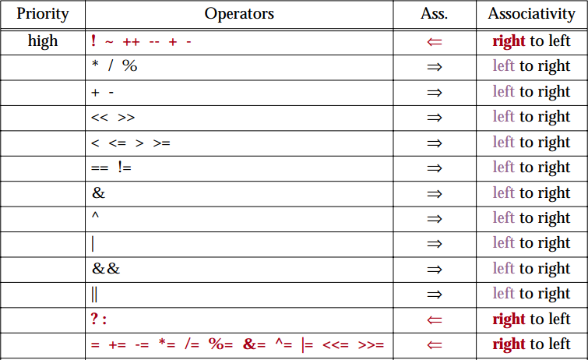
Precedence Rules
(Unary Operators)
(Binary Operators)

Slide 27
Precedence Rules – Example 1
6 + 2 * 3 - 4 / 2
6 + 6 - 4 / 2
6 + 6 - 2
12 - 2
10

Slide 28

Precedence Rules – Example 2
3 * 4 / 2 + 3 - 1
12 / 2 + 3 - 1
6 + 3 - 1
9 - 1
8

Slide 29
Precedence Rules – Example 3
8 * 3 | / 2 + | 3 | - 1 | 8 | / | 3 | * 2 + 3 | - 1
24 / | 2 + 3 | - | 1 |  | 2 | * | 2 + 3 - | 1
12 | + 3 - 1 |  |  |  |  | 4 | + 3 - 1
15 - 1 14 |  |  |  | 7 - 1 6

Slide 30
Precedence Rules (overriding)
For example: x = 3 * a - ++b % 3;
If we intend to have the statement evaluated differently from the way specified by the precedence rules, we need to specify it using parentheses ( )
Using parenthesis:
x = 3 * ((a - ++b)%3);

Slide 31
Numeric Type Conversion
Consider the following statements:
short i = 10; long k = i * 3 + 4;
double d = i * 3.1 + k / 2; cout<<d;

Slide 32
Type Conversion Rules
Auto Conversion of Types in C++
If one of the operands is long double, the other is converted into long double
Otherwise, if one of the operands is double, the other is converted into double.
Otherwise, if one of the operands is unsigned long, the other is converted into unsigned long.
Otherwise, if one of the operands is long, the other is converted into long.
Otherwise, if one of the operands is unsigned int, the other is converted into unsigned int.
Otherwise, both operands are converted into int.

Slide 33
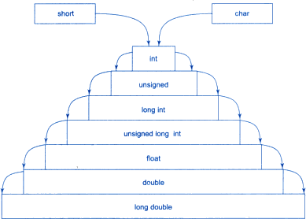
Implicit Type Conversion in C++

Slide 34
Typecasting
A mechanism by which we can change the data type of a variable (now matter how it was originally defined)
Two ways:
Implicit type casting (done by compiler)
Explicit type casting (done by programmer)

Slide 35
Implicit type casting
As seen in previous examples:
void main()
{
char c = 'a';
float f = 5.0; float d = c + f;
cout<<d<<“ “<<sizeof(d)<<endl; cout<<sizeof(c+f);
}

Slide 36
Explicit type casting
Explicit casting performed by programmer. It is performed by using cast operator
float a=5.0, b=2.1;
int c = a%b; // → ERROR
Three Styles
int c = (int) a % (int) b; int c = int(a) % int(b);
//C-style cast
// Functional notation
int c = static_cast<int>(a) % static_cast<int>(b); cout<<c;

Slide 37
Explicit Type Casting
- Casting does not change the variable being cast.
For example, d is not changed after casting in the following code:
double d = 4.5;
int j = (int) d; //C-type casting
int i = static_cast<int>(d); // d is not changed cout<<j<<“ “<<d;

Slide 38
Widening type casting
A "widening" cast is a cast from one type to another, where the "destination" type has a larger range or precision than the "source“
Example:
int i = 4; double d = i;

Slide 39
Narrowing type casting
A “narrowing" cast is a cast from one type to another, where the "destination" type has a smaller range or precision than the "source“
Example:
double d = 787994.5; int j = (int) d;
// or
int i = static_cast<int>(d);

Slide 40
Casting between char and Numeric Types
int i = 'a';
// Same as
int i = (int) 'a';
char c = 97;
// Same as
char c = (char)97;

